Slide 1
CSI2P(I) 2019 Spring
Midterm 2 Exercise

Slide 2
12154 – You shall not pass!
Input:
  n x n matrix: meteors
  k numbers: sputum
Output:
  Whether sputum can defend all meteors

Slide 3
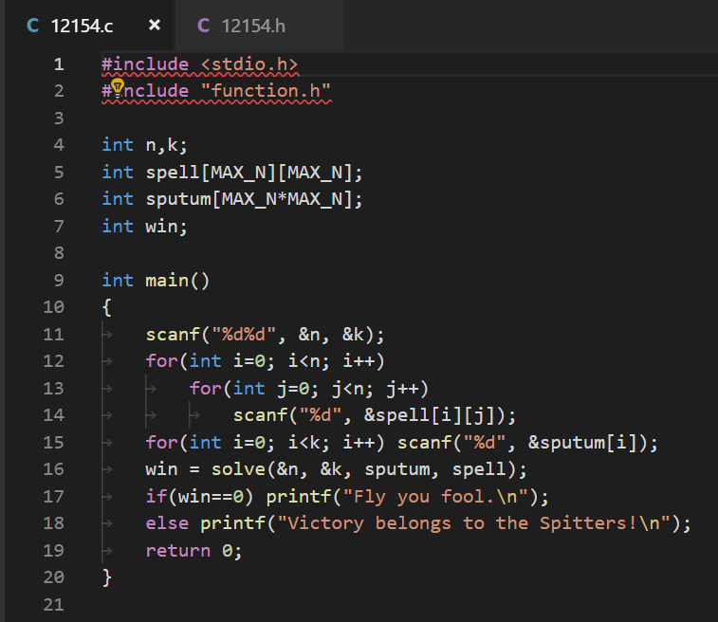
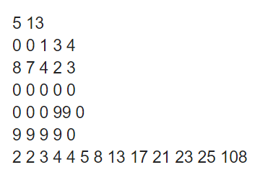
12154 – You shall not pass! (cont.)
Partial Judge

Slide 4
12154 – You shall not pass! (cont.)
Solution
  Irrelevant to matrix
    Can seem it as a sequence
  Try to use possible minimum number to offset meteors

Slide 5


12154 – You shall not pass! (cont.)
Solution
When encountering each element in matrix, the element is compared with number in sputum sequence (increasing sequence) from beginning to end
Sort matrix first and get one increasing input sequence, and then compare it with sputum sequence from both their beginning to end (faster method)

Slide 6
12178 – Queens and Castles
Input: M, N
Output: A single number
Interpretation:
  M castles
  N Queens
  Calculate the all possibilities, where all queens and castles are in palace.
  Last but not least, they should not see each other.

Slide 7
12178 – Queens and Castles
Solution – Recursion
  We start from zero queens and zero castles.
  We recursively put queens and castles on the board (palace), with the constraint of the rule of their own.
  The recursion ends when
    All of the queens and castles are put.
    The number of them == (M+N)

Slide 8
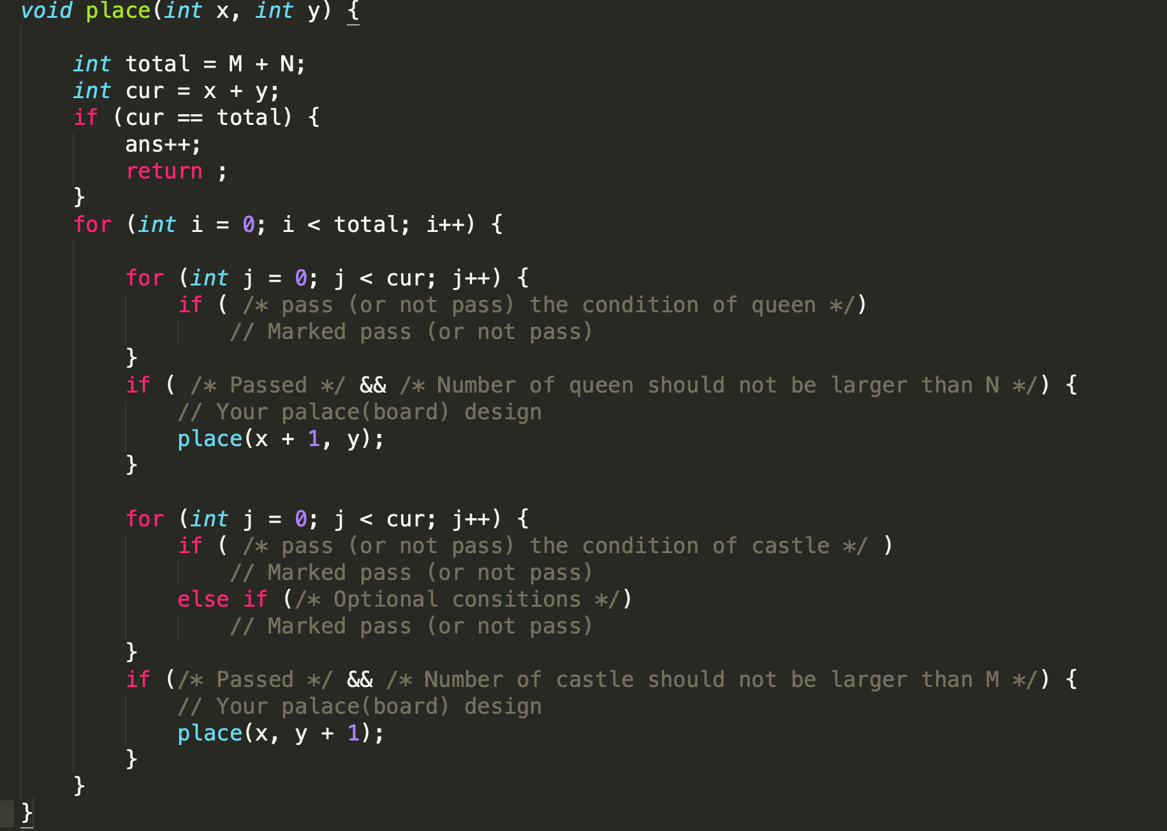
12178 – Queens and Castles

Slide 9
12179 – Queens
Input:
  n denote n*n chessboard
Output:
  Total amount of states that queens are placed in the palace

Slide 10
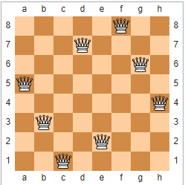
12179 – Queens (cont.)
Solution
  Use recursion to count all possible

Slide 11
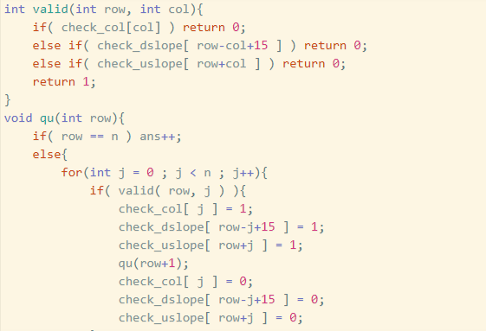
12179 – Queens (cont.)
Solution
  Use recursion to count all possible

Slide 12
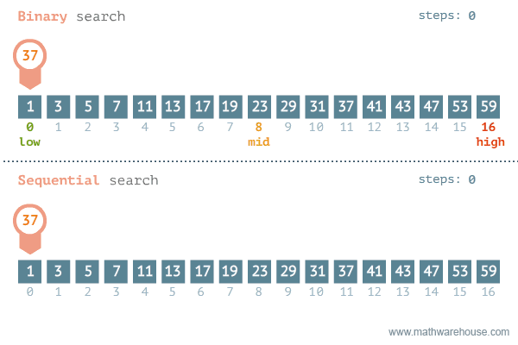
12194 – de way to home

Slide 13
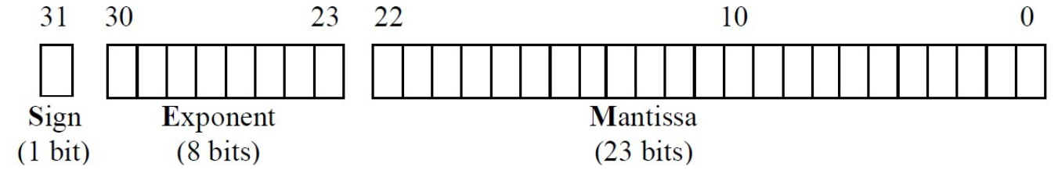
12237 – TA’s Heartfelt
Description
  You are given a IEEE-754 floating number with single precision (which is type "float" in C)
  You are going to output every bit of the number, from the largest bit to the smallest bit (including every 0)

Slide 14
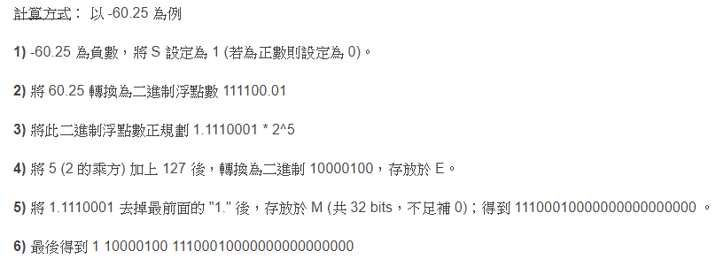
12237 – TA’s Heartfelt (cont.)
Traditional calculation

Slide 15
12237 – TA’s Heartfelt (cont.)
Use the concept of pointer
  Get the storing number in memory (It will store as IEEE-754 format)
  Cannot get binary representation directly → Decimal to Binary Problem
  May confuse
  (int) a 將a的值轉換成int類型
  (int*)a 將a轉換成int類型的指標變數
  (int)&a 把a的地址強制轉換成整型
  *(int*)&a 直接得到a在內存單元的值，並將其轉換成整數輸出
  [補充] == (int&)a in C++
  Remember convert the negative number into positive one
  If so, the sign bit will be “1”
Notes:
不经过转换，直接得到a在内存单元的值，并将其转换成整数输出

Slide 16
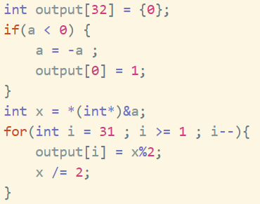
12237 – TA’s Heartfelt (cont.)
&a takes the address of a, a float
(int *) keeps the same address but tells the compiler that an int is stored there
int i = * then loads the int from that address.
Notes:
不经过转换，直接得到a在内存单元的值，并将其转换成整数输出

